Slide 1
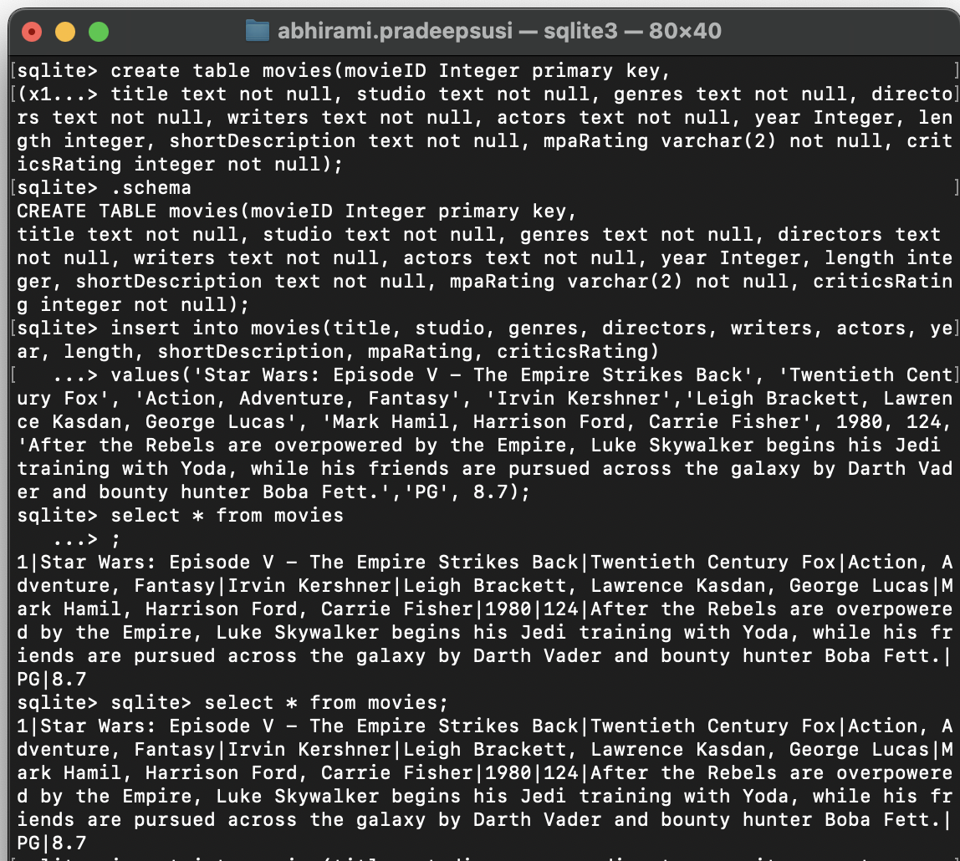
Part 1 Creating your database
1. Use the excel file as a starting point. Create the same columns that are included in the excel file. This is your database's schema.
2. Your Primary key is movieID and should be automatically incrementin..
3. Add the movies provided in the excel file and at least 10 of vour own..

Slide 2
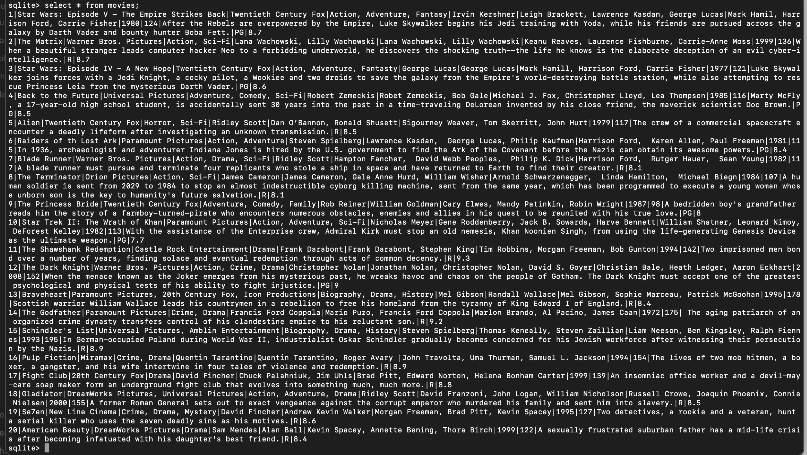
Part 2 Querying your database:
4. Create a SQL Query that displays all of the movies in the database

Slide 3
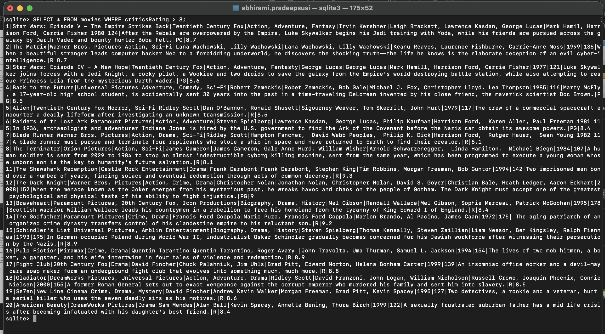
Part 2 Querying your database:
5. Create a SQL Query that displays all the movies with a rating greater than 8.

Slide 4
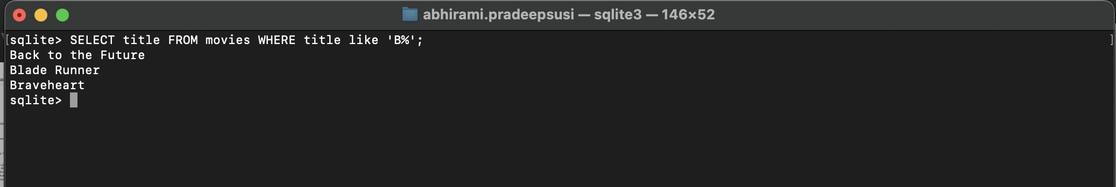
Part 2 Querying your database:
6. Create a SQL Query that displays all the movies titles that start with a B

Slide 5
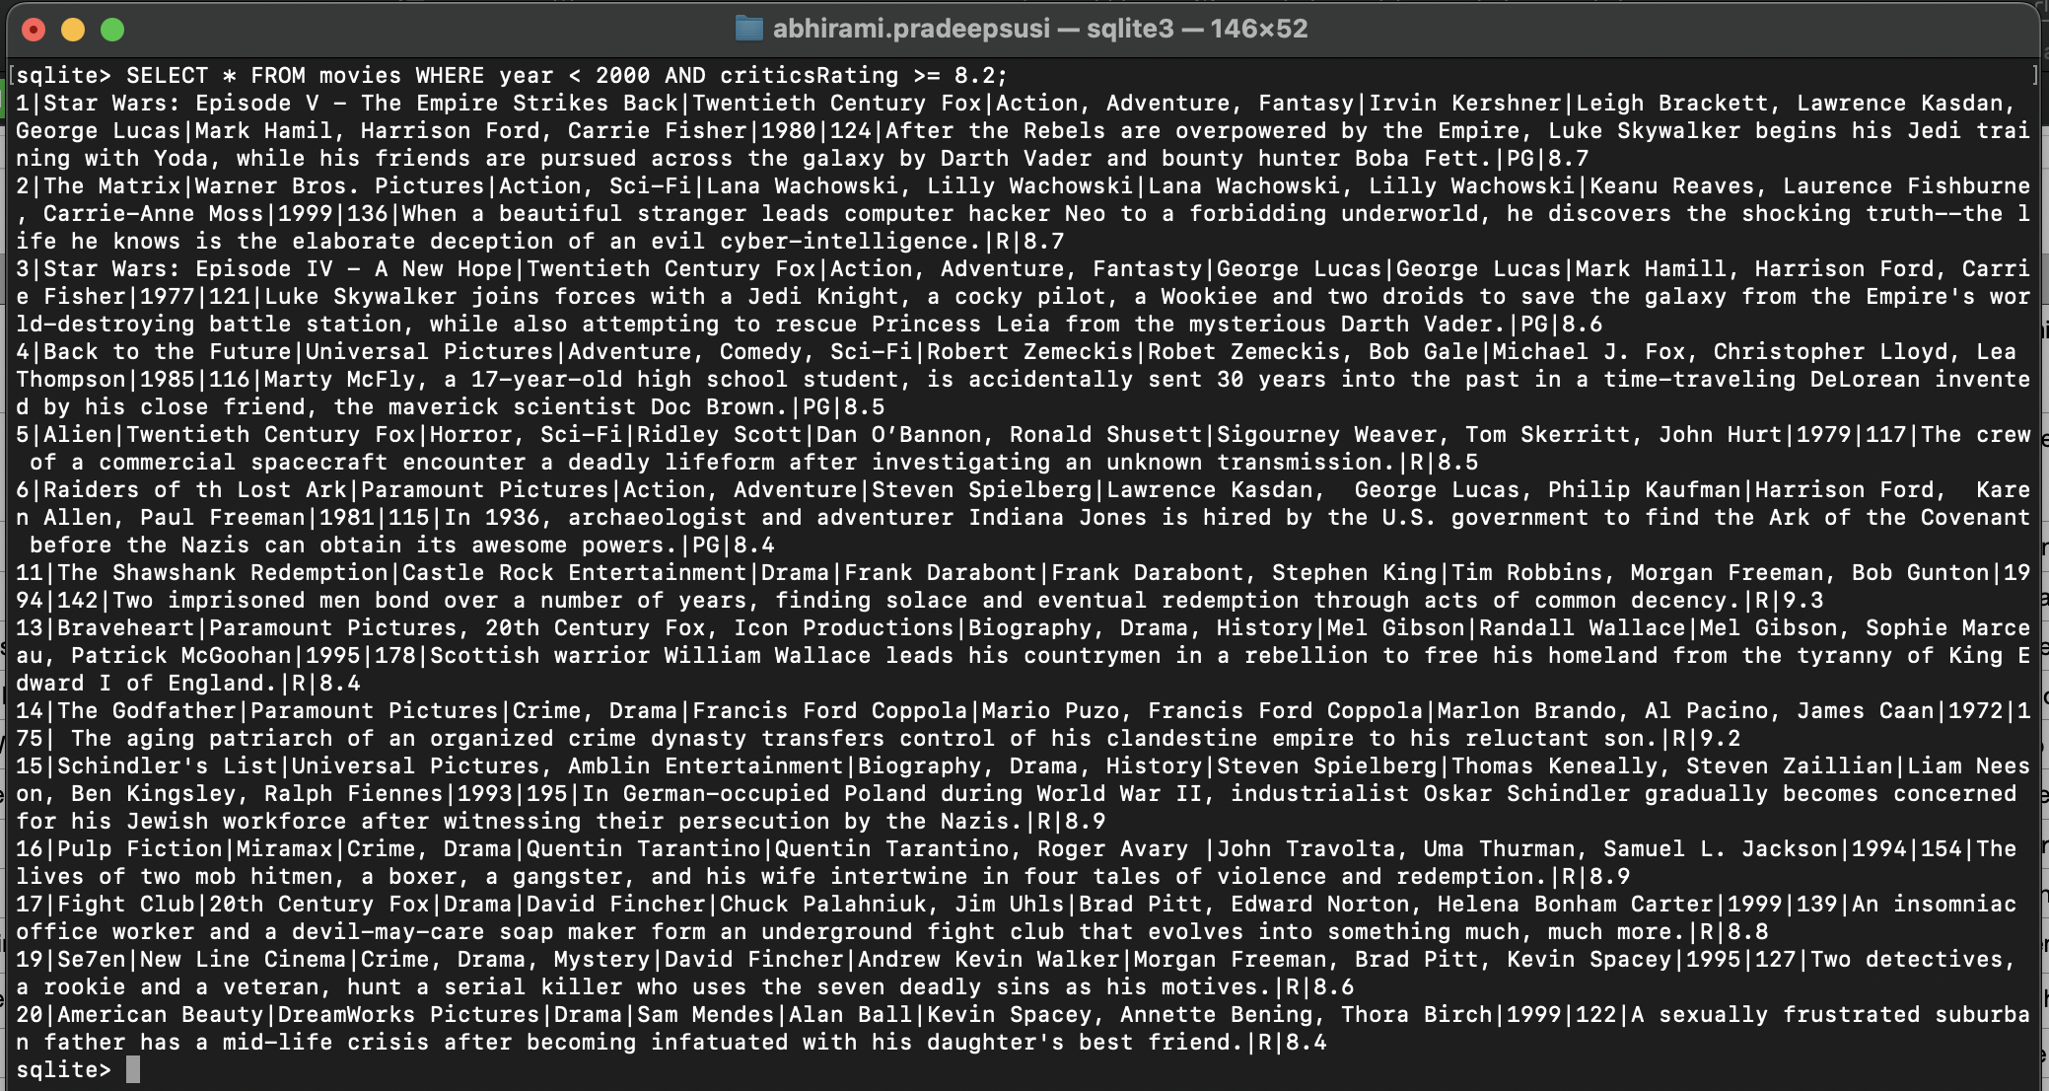
Part 2 Querying your database:
7. Create a SQL Query that displays all movies that were released prior to 2000, where the rating is 8.2 or greater.

Slide 6
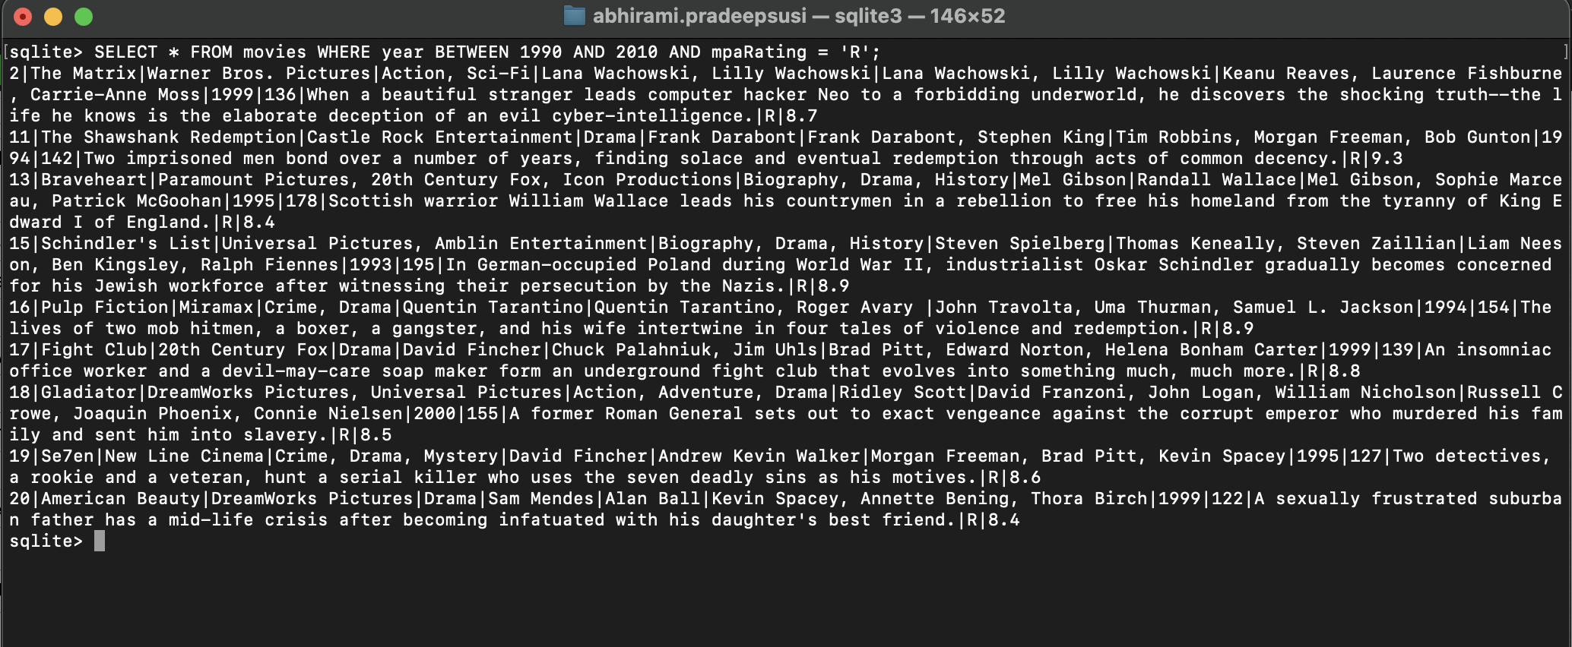
Part 2 Querying your database:
8. Create a SQL Query that displays all movies that were released between 1990 and 2010, with an mpaRating of 'R'.

